Slide 1
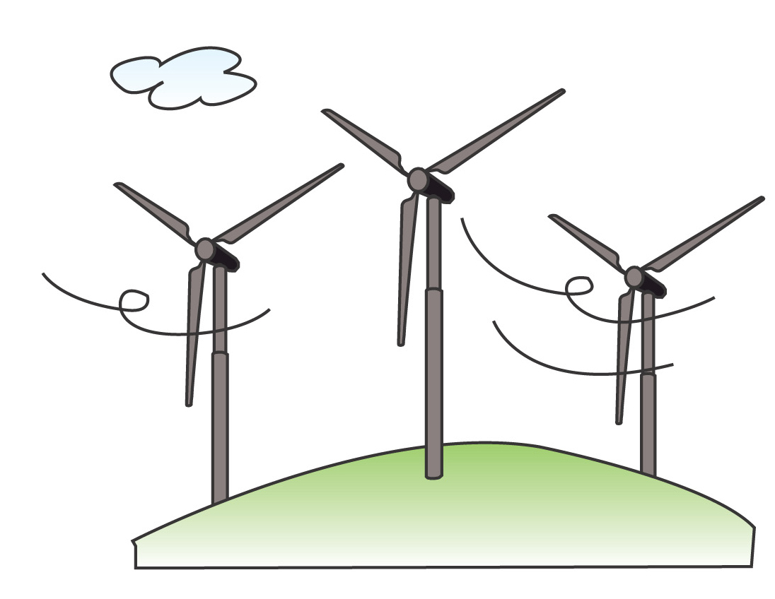
PowerPoint Series on Geography of China (6) – Energy resources of our country
Personal, Social and Humanities Education Section,
Curriculum Development Institute, Education Bureau
Teacher Version

Slide 2
Notes to Teachers – The learning & teaching of energy resources of China and its linkages with the junior secondary geography curriculum
When teaching the module – “Scramble for Energy” in the Geography Curriculum Guide (Secondary 1-3) (2011), teachers can teach the information in this PowerPoint as an example to give students a basic understanding of our country's energy resources.

Slide 3
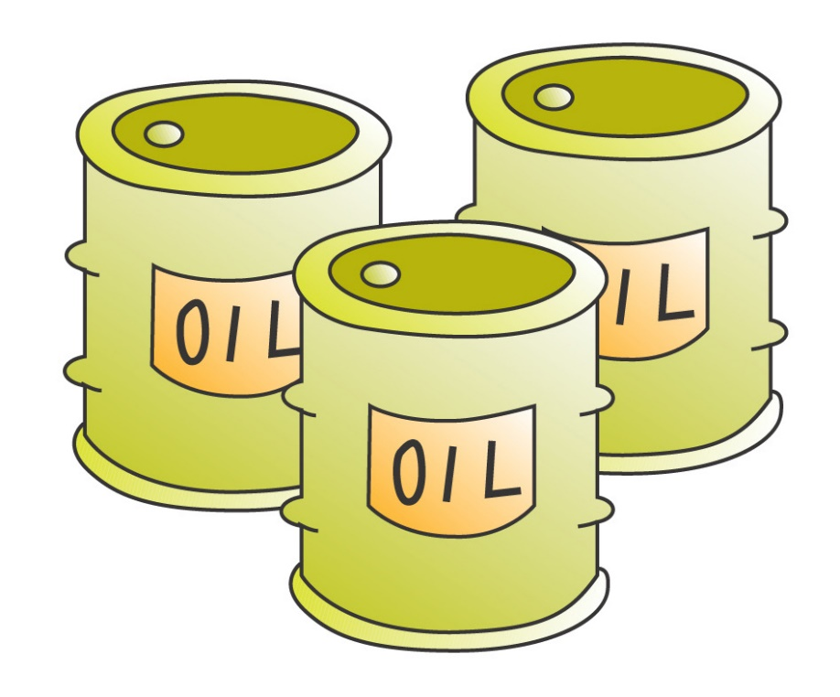
Types of energy resources in our country
Our country's energy resources are rich and diverse. Examples include：
coal
oil & natural gas
oil shale
geothermal
hydroelectric power
wind energy
Non-renewable energy resources
Renewable energy resources

Slide 4
Examples of non-renewable energy resources
1) Coal :
Our country's known coal-bearing area accounts for about 5.7% of the country's land area. It is estimated that our country's total coal reserves within 2,000 meters of depth rank third in the world after Russia and the United States. Of the proven reserves, bituminous coal accounts for 75%, anthracite coal accounts for 12%, and lignite coal accounts for 13%. According to the current mining speed, coal mining in our country can continue for about 500 years.

Slide 5
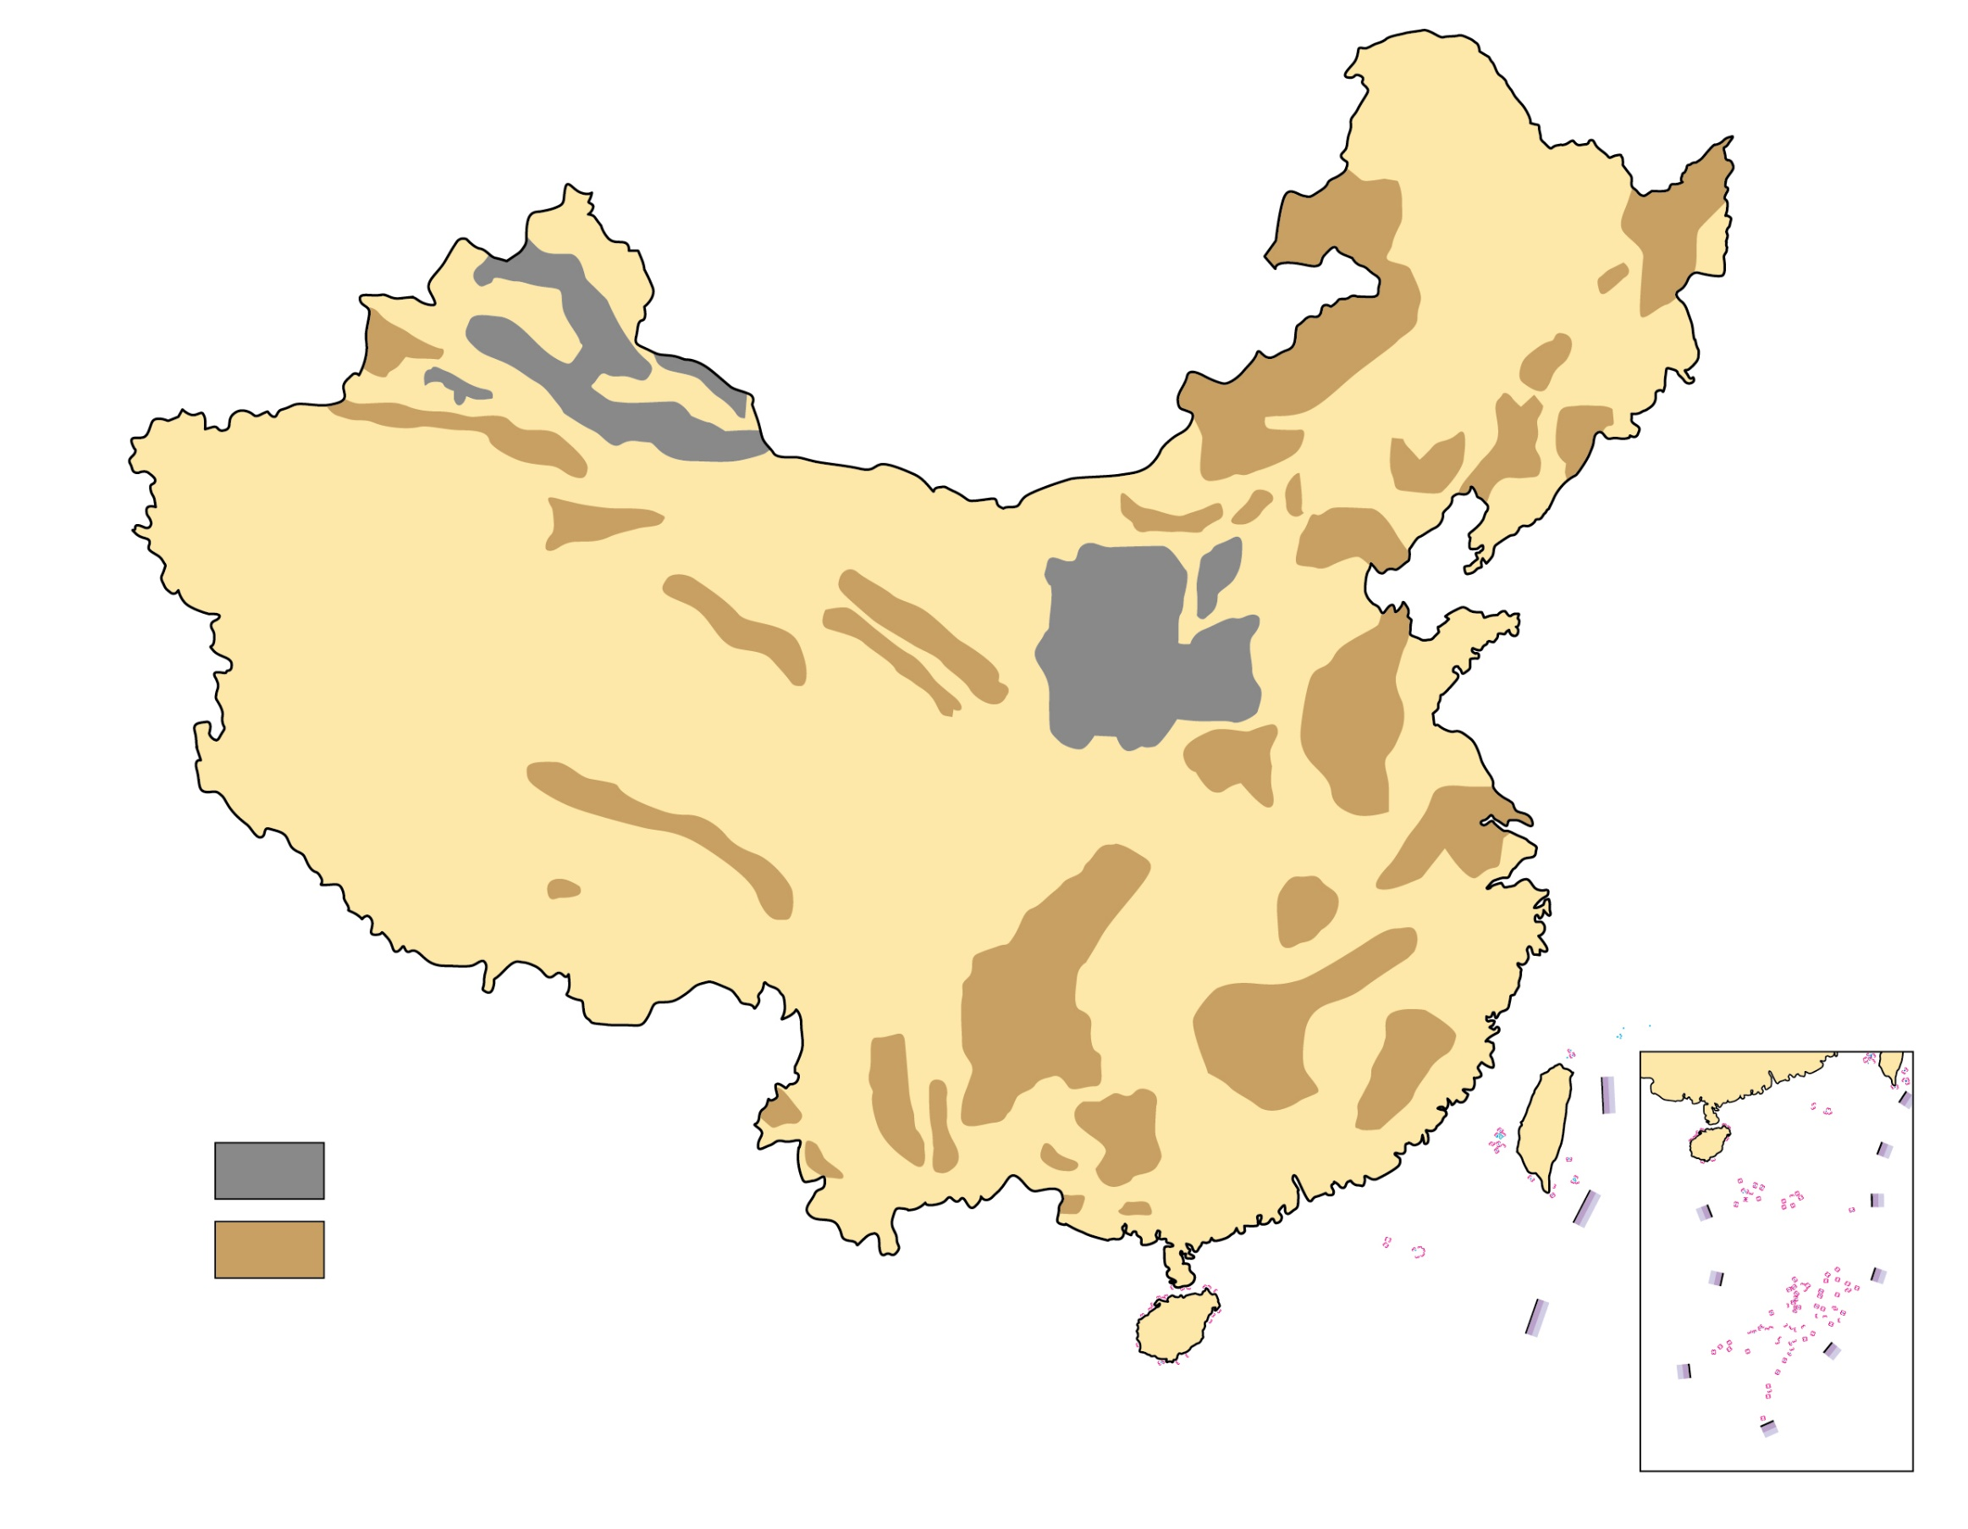
Figure 1 The distribution of coal resources in our country
(Source: P.172 of the book “Learning the Geography of China through Reading (Part 1): The physical environment” published by the Education Bureau (Hong Kong) in 2013.)
Key
Coal field
Coal-containing area
*No data for Nan Hai Islands

Slide 6
In terms of the overall distribution of coal in our country, there is more in the north and less in the south (Figure 1). If Chang Jiang is set as the boundary, the area north of Chang Jiang accounts for more than 90% of the reserves, of which Shanxi, Shaanxi and Nei Mongol account for 64%. On the contrary, most provinces in the south are short of coal.
2) Oil & natural gas ：
Although our country's oil and gas resources are abundant, its per capita reserves are only 1/9 of the world's per capita. Our country has changed from a net oil exporter to a net importer since the 1990s.

Slide 7
About 340 oil and gas basins have been discovered in our country, and more than 440 oil and gas fields have been discovered in the 145 proven basins. New oil and gas resources are expected to be discovered continuously.
Our country's oil resources are mainly concentrated in the following three regions in North China (“Three-North” regions) (Figure 2):
Northeastern region (e.g. Daqing Oil Field in Songliao Basin)
Northern part of our country (e.g. Shengli Oil Field)
Northwestern part of our country (e.g. Tarim Basin, Qaidam Basin and Zungar Basin)

Slide 8
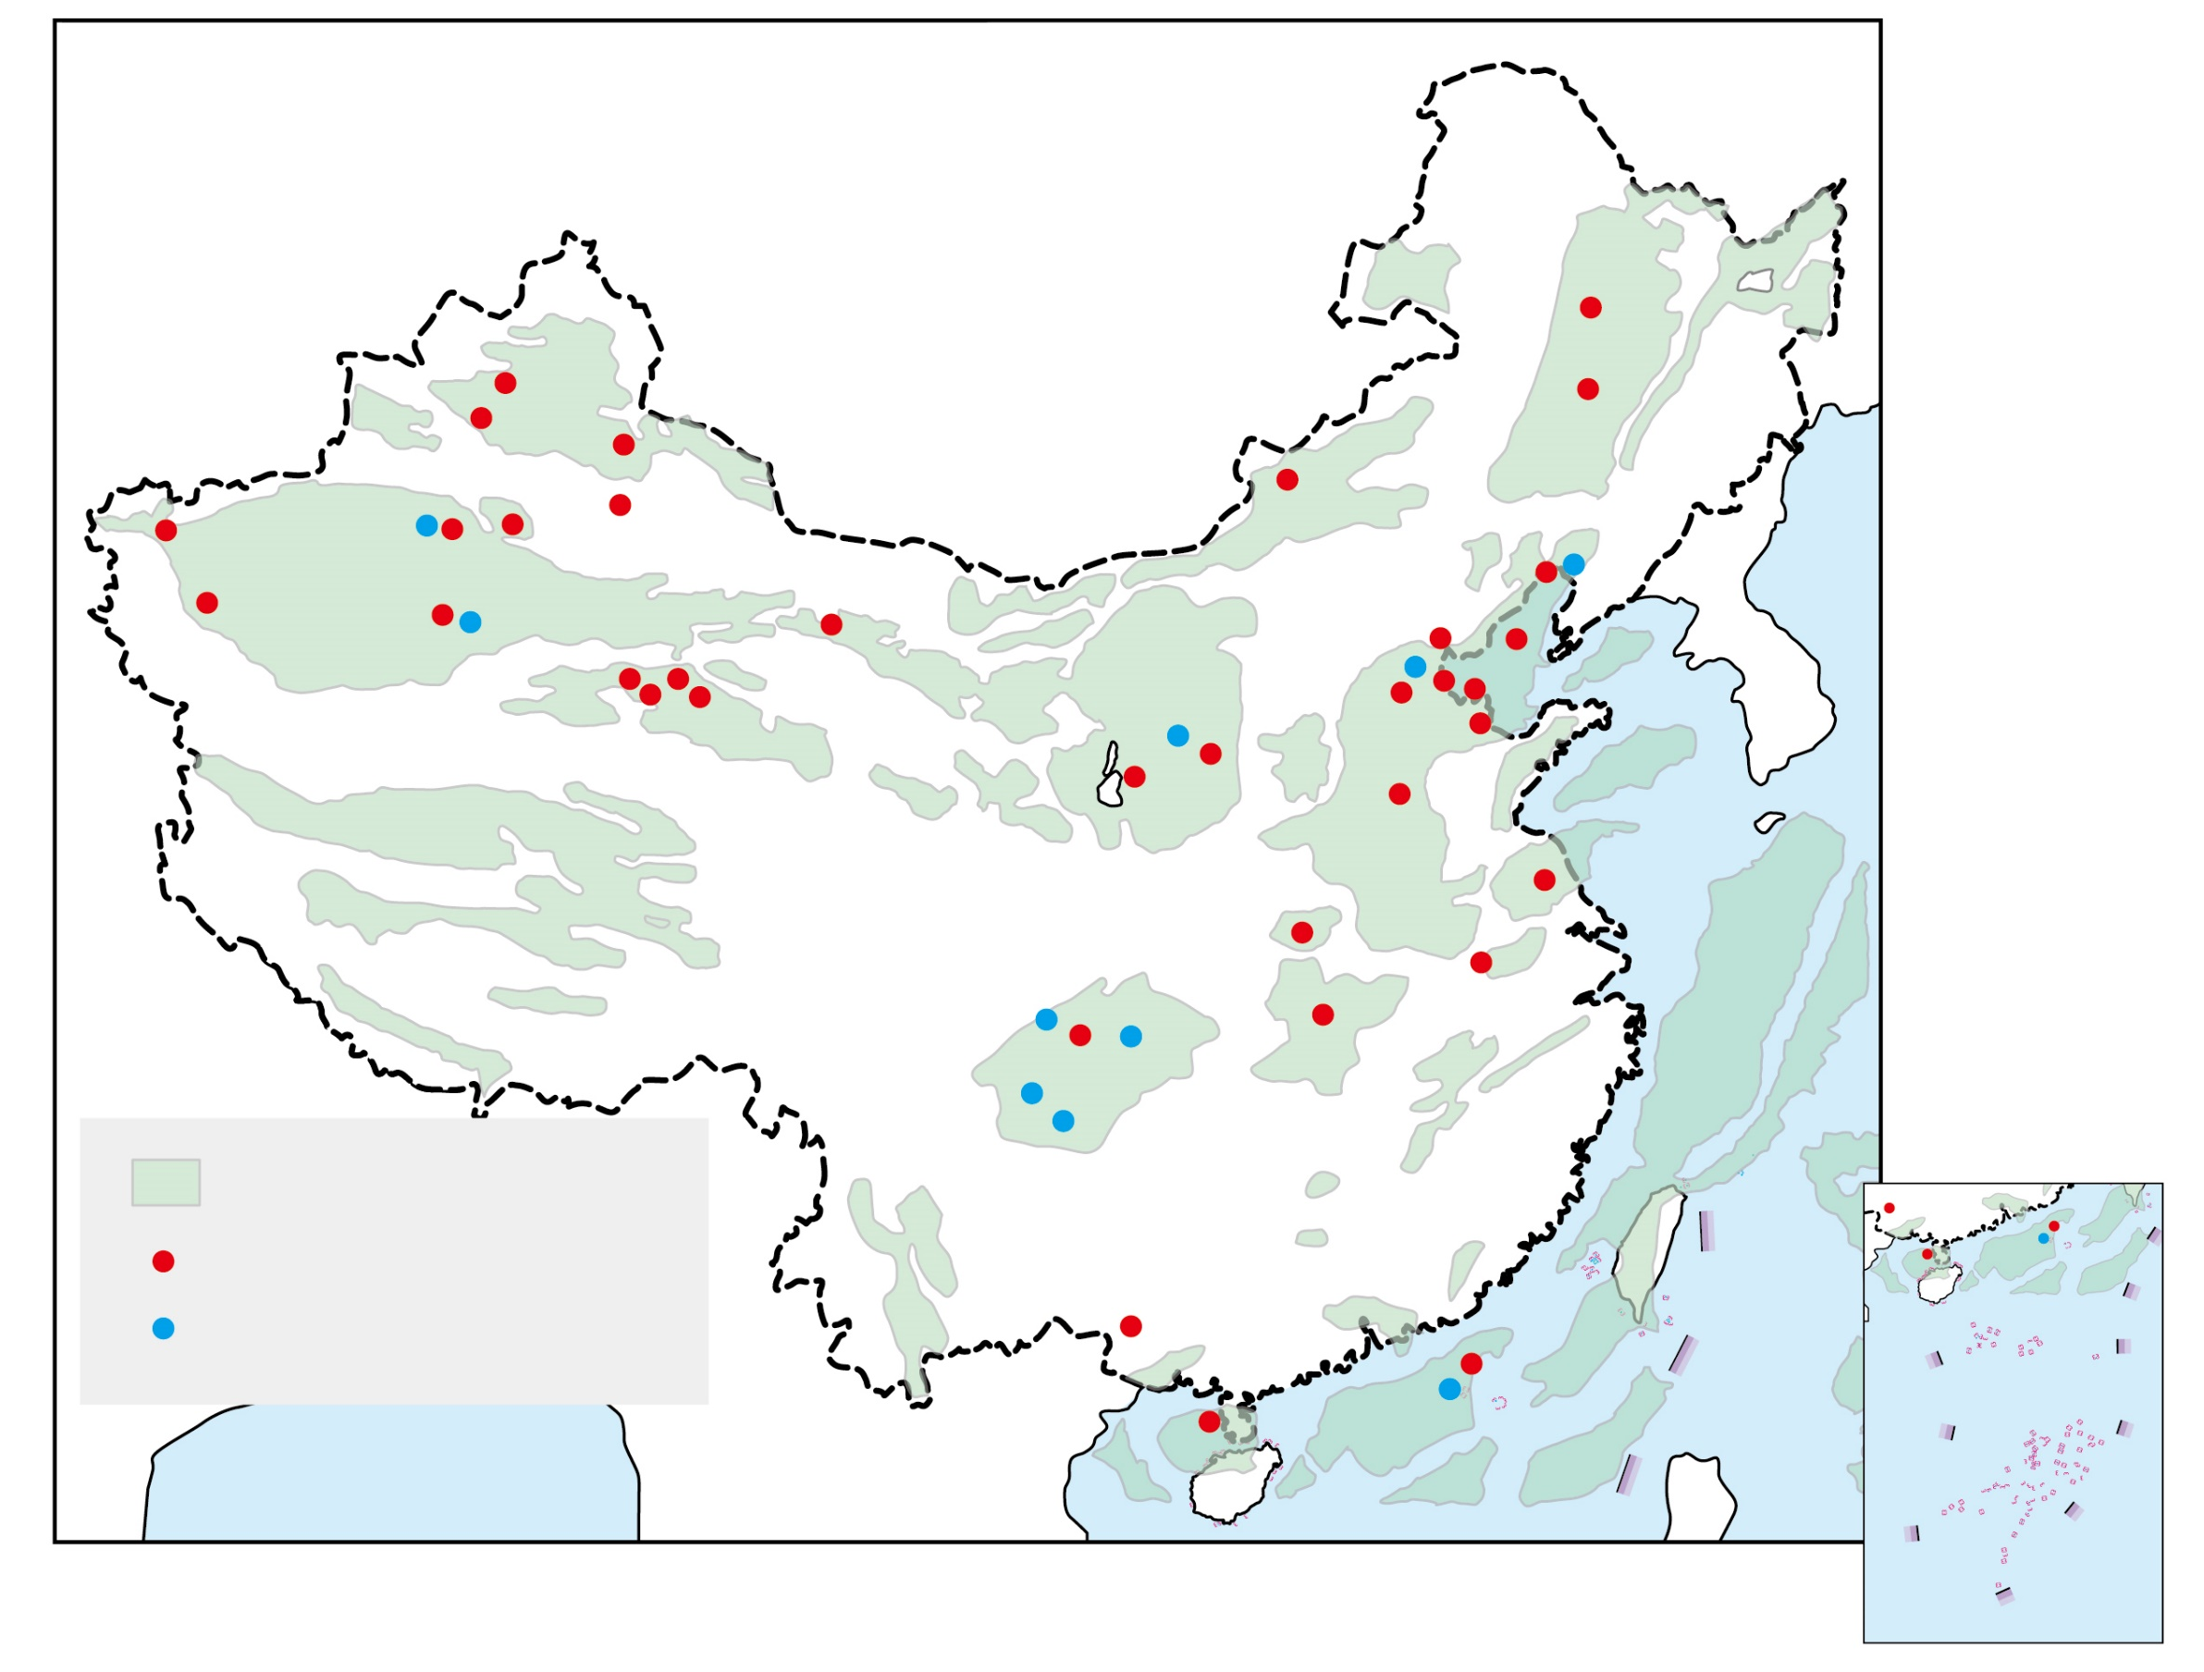
Figure 2 The distribution of oil & natural gas
resources in our country
(Source: P.173 of the book “Learning the Geography of China through Reading (Part 1): The physical environment” published by the Education Bureau (Hong Kong) in 2013.)
Oil and natural gas containing basin
Oil field
Natural gas field
*No data for Nan Hai Islands

Slide 9
Examples of renewable energy resources
Examples of renewable energy which have developed relatively mature in our country include hydroelectric power, solar energy and wind energy.
1) Hydroelectric power:
- In terms of amount of river flows, our country is one of the countries in the world richest in water resources.
- The distribution of our country's water energy is the most abundant in rivers of the southwestern regions and Chang Jiang, but the demand for electricity is mainly concentrated in the eastern coastal regions.

Slide 10
Table 1 Examples of the distribution of hydroelectric power resources in our country
River system | Theoretical annual power generation (billion kWh） | Actual annual power generation (billion kWh）
Rivers in South China | 293.3 | 112.5
Rivers in southwestern part of our country | 2,248.2 | 506.8
Chang Jiang | 2,347.8 | 1,027.5
Huang He | 355.2 | 117.0
Huaihe | 12.7 | 1.9

Slide 11
The power of generating hydroelectricity of a river depends on two factors: amount of runoff and whether a large drop in elevation is present. The topography of our country is high in the west and low in the east, showing a pattern of tiers. Many rivers in our country have a large drop in elevation when flowing through the junctions of the tiers and turbulent water flows are found at such junctions, so the water power reserves are huge (Figure 3).
Our country's hydroelectric power reserves reach 680 million kilowatts, ranking first in the world, of which the Chang Jiang river system, and the upper and middle courses of Huang He and Zhujiang are particularly rich.
Most of the hydroelectric power stations that have been developed in our country are mainly found in the upper courses of Chang Jiang, Huang He and Zhujiang.
Overall, there are more hydroelectric power resources 1) in South China than North China and 2) in the western part of China than East China.

Slide 12
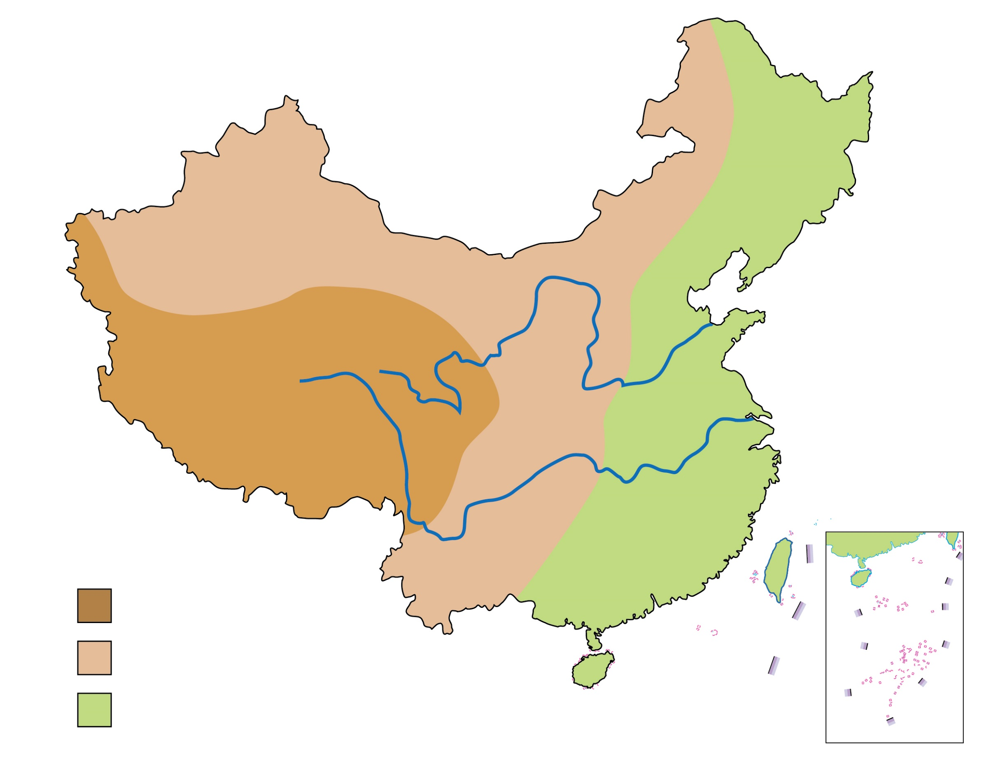
Figure 3 A map showing the three-tier pattern of relief & major rivers of our country (& related information)
River | Length of the river (Source of data：《China Statistical Yearbook 2021》) | Annual runoff (Source of data：《China Statistical Yearbook 2021》)
Huang He | 5,464 km | 59.2 billion cubic meters
Chang Jiang | 6,300 km | 985.7 billion cubic meters
Huang He
Chang Jiang
Key
1st tier / step
2nd tier / step
3rd tier / step

Slide 13
2) Solar energy:
Our country is one of the countries rich in solar energy resources, and about 2/3 of the country has more than 2,000 hours of sunlight per year.
The total solar radiation in our country is the highest in Xizang, while regions with relatively high total solar radiation include Qinghai, Xinjiang, Gansu, Ningxia and parts of Sichuan (Figure 4).

Slide 14
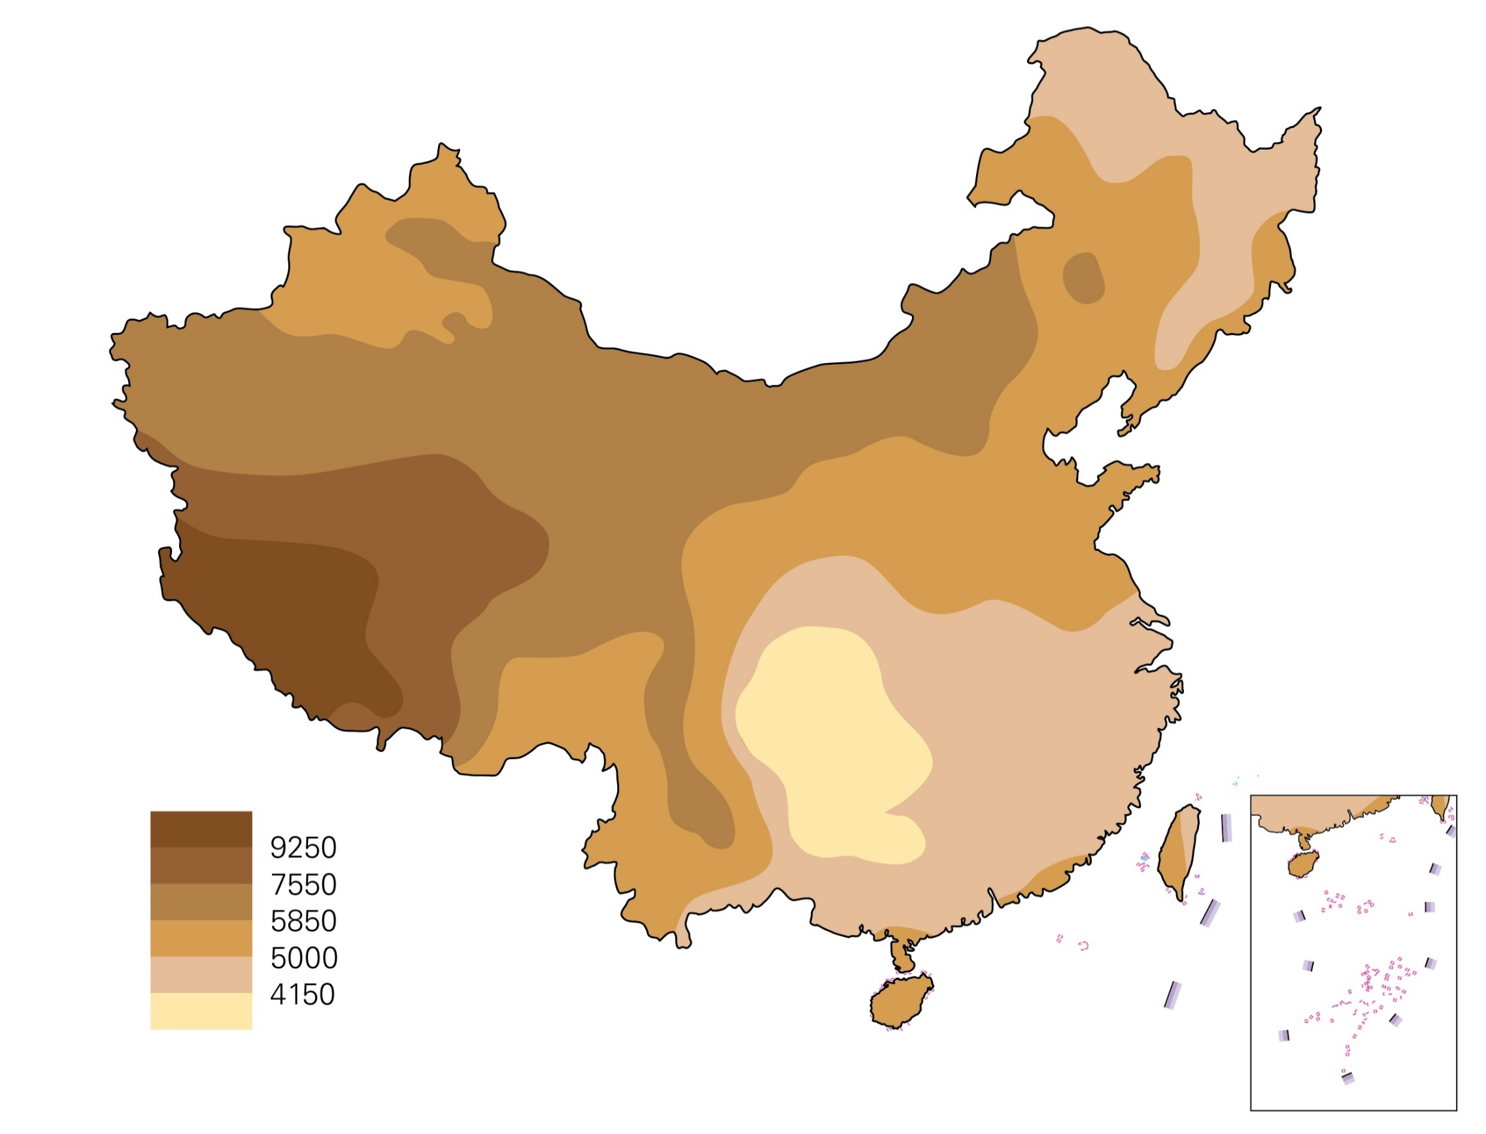
Figure 4 The distribution of solar energy resources
in our country
(Source: P.176 of the book “Learning the Geography of China through Reading (Part 1): The physical environment” published by the Education Bureau (Hong Kong) in 2013.)
Key
*No data for Nan Hai Islands

Slide 15
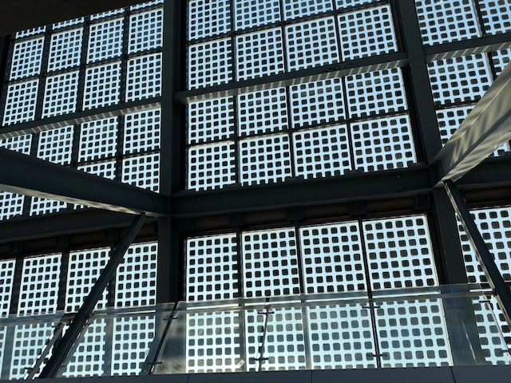
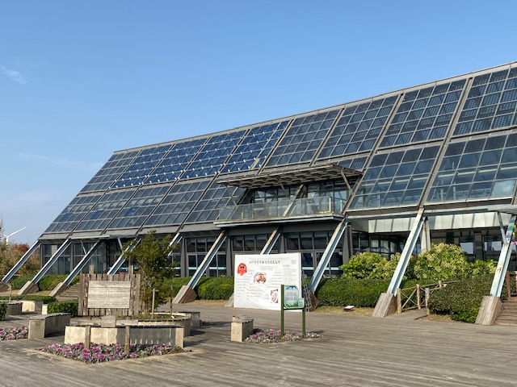
Figure 5 Solar energy facilities on Chongming Island in Shanghai

Slide 16
3) Wind energy：
Our country is rich in wind energy resources, including inland and offshore wind energy (Figures 6 and 7) .
In terms of distribution, the regions with the most abundant wind energy resources in our country are the northeastern, northern and northwestern parts of our country (Figure 8).

Slide 17
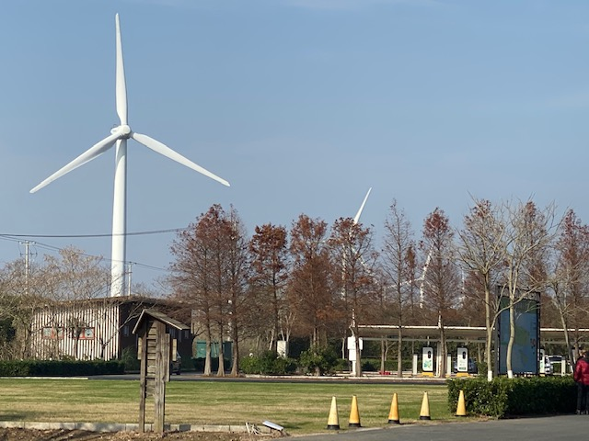
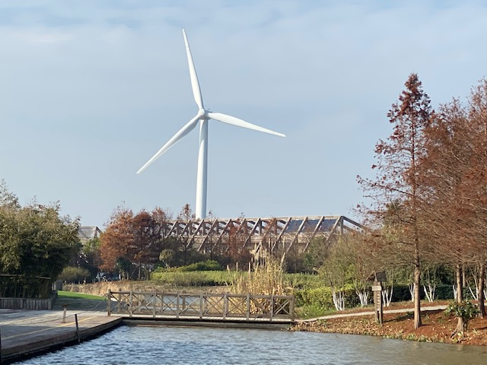
Figure 6 Wind power facilities on Chongming Island in Shanghai

Slide 18
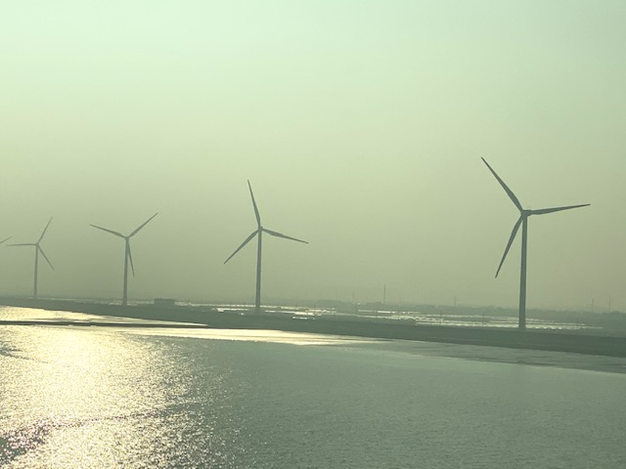
Figure 7 Wind power facilities at the sea near Chongming Island in Shanghai

Slide 19
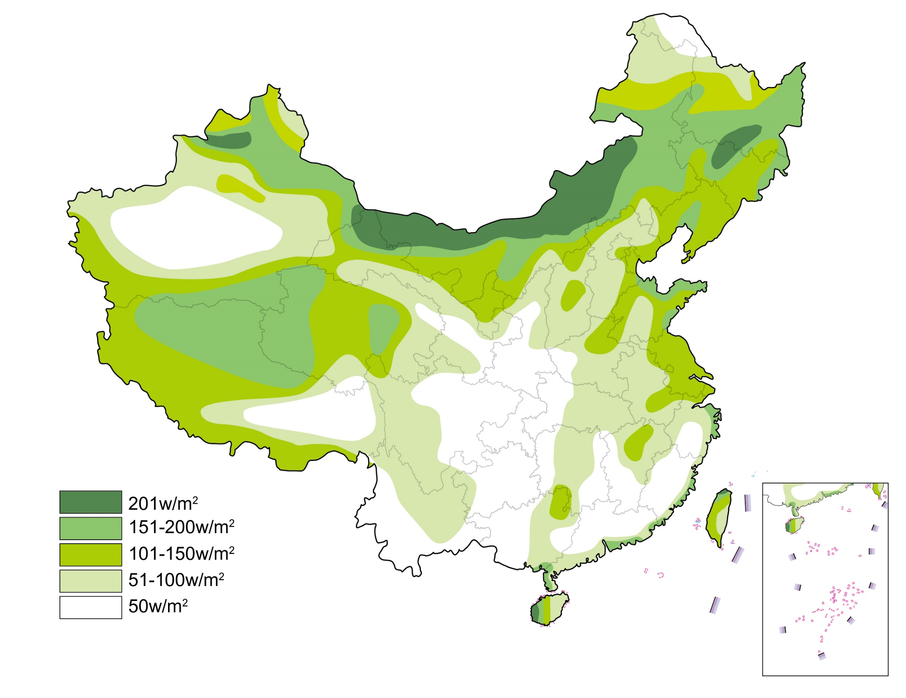
Figure 8 The distribution of wind resources in our country
(Source: P.176 of the book “Learning the Geography of China through Reading (Part 1): The physical environment” published by the Education Bureau (Hong Kong) in 2013.)
Key
*No data for Nan Hai Islands

